Slide 1

2Annual Title I Meeting
Crump Elementary School
Tuesday, August 26, 2025
5:00p.m.
Wednesday, August 27, 2025
9:00a.m.
LEARN. LEAD. LEAVE A LEGACY.

Slide 2
Topic (Agenda) | Presenter
Agenda and Welcome | Dr. Curry, Principal
Introduction of Faculty | Ms. Marion Gross, PLC Coach
Family and Engagement Specialist | Ms. Valerie Jones
Title I Information What is a Title I school? What are my rights? What can Title I funds be used for? How does our school use Title I funds? What is the SIP? What are our school wide program goals? How is parent and family engagement funded? What is the Parent and Family Engagement Policy? What is the School-Parent Compact? What curriculum does our school use? What tests will my child be taking? How can I be involved? Whom can I contact for help | Ms. Marion Gross, PLC Coach Dr. Krystal Polk, PLC Coach
Closing Remarks/Housekeeping | Dr. Curry, Principal

Slide 3

Crump Elementary School is committed to excellence. Our school is dedicated to equipping teachers with the tools they need to provide a high-quality education to students they serve. We utilize data to drive instruction in order to meet the needs of every learner in every classroom. We are intentional, and we are producing well-rounded, high-achieving students that are lifelong learners, risk takers, problem solvers, and critical thinkers.
LEARN. LEAD. LEAVE A LEGACY.
Notes:
Opportunity for participant volunteer response after the question appears

Slide 4

PreK Teachers
PreK-01 - Mrs. Short
PreK-02 - Ms. Delancey
PreK-03 - Ms. Hawkins

Slide 5
Kindergarten Teachers
KK-01- Mrs. Henderson
KK-02- Ms. Thompson
KK-03- Mrs. Gilbert
KK-04- Ms. Thompson-Kimbrough

Slide 6
1st Grade Teachers
1-01- Ms. Howard
1-02- Ms. Santiago
1-03- Mrs. Poplar-Douglas
1-04- Ms. Williams

Slide 7
2nd Grade Teachers
2-01- Ms. C. Smith
2-02- Ms. Linsey
2-03- Mrs. Blake
2-04- Ms. Brown

Slide 8
3rd Grade Teachers
3-01- Mrs. Porter
3-02- Mrs. Stovall Jones
3-03- Mrs. McNutt
3-04- Ms. Tillman

Slide 9
4th Grade Teachers
4-01- Ms. Lee
4-02- Ms. Douglas
4-03- Ms. Oliver

Slide 10
5th Grade Teachers
5-01- Ms. Hardin
5-02- Mrs. McCollins
5-03- Ms. Acey

Slide 11
Support Teachers
Coach Wells – P.E. (KK, 2nd, & 4th)
Coach Price – P.E. (1st, 3rd, & 5th)
Ms. Hoffman - Music
Ms. Weatherall - Art
Mr. Seaberry - Library

Slide 12
ELL & Instructional Resource Teachers
Ms. Heard - ELL
Ms. Hill - ELL
Ms. Y. Owens - ELL
Mrs. Eddins –
Instructional Resource
Ms. Connor –
Interventionist

Slide 13
Title I Meeting Purpose
The Every Student Succeeds Act (ESSA) requires that each Title I school hold an annual meeting for Title I families in order to:
      -inform you of your school’s participation in Title I
      -explain the requirements of Title I
      -explain your rights as parents and family members to be involved
LEARN. LEAD. LEAVE A LEGACY.
Notes:
Opportunity for participant volunteer response after the question appears

Slide 14
What You Will Learn During This Meeting
What is a Title I school?
What are my rights?
What can Title I funds be used for?
How does our school use Title I funds?
What is the SIP?
What are our schoolwide program goals?
How is parent and family engagement funded?
What is the Parent and Family Engagement Policy?
What is the School-Parent Compact?
What curriculum does our school use?
What tests will my child be taking?
How can I be involved?
Who can I contact for help?
LEARN. LEAD. LEAVE A LEGACY.
Notes:
Opportunity for participant volunteer response after the question appears

Slide 15
What is a Title I School?
Title I was passed in 1965 under the Elementary and Secondary Education Act (ESEA). It is the largest federal assistance program for our nation’s schools.
Title I schools receive extra funding from the federal government. These dollars are used to:
identify students experiencing academic difficulties and provide assistance to help these students;
purchase additional staff, programs, materials, and/or supplies;
And conduct parent and family engagement meetings, trainings, events, and/or activities.
LEARN. LEAD. LEAVE A LEGACY.
Notes:
Opportunity for participant volunteer response after the question appears

Slide 16
How can Title I funds be used?
Title I funds may be used for:
Smaller class sizes
To employ additional teachers and paraprofessionals to assist in the education process
Provide additional training for school staff
To provide extra time for instruction (before and/or after school programs)
Provide Parent and family engagement activities, and/or
Purchase a variety of supplemental teaching materials, equipment, and technology.
LEARN. LEAD. LEAVE A LEGACY.
Notes:
Opportunity for participant volunteer response after the question appears

Slide 17
What is the SIP?
The SIP is the School Improvement Plan.
It is a plan or a road map that addresses the changes a school needs to make to improve the level of student achievement.
It’s a plan that has goals, strategies and action steps that are needed to address the academic and non-academic needs of our students.
The plan also provides insight on the budget, resources, and professional development needs of our faculty and staff.
LEARN. LEAD. LEAVE A LEGACY.
Notes:
Opportunity for participant volunteer response after the question appears

Slide 18
What is a Family and Engagement
Policy?
These plans address how the district and school will
implement the parent and family engagement requirements of ESSA. Components should include:
how parents and families can be involved in decision-making and activities;
how parent and family engagement funds are being used;
how information and training will be provided to families; and
how the school will build capacity in families and staff for strong parent and family engagement.
You, as a Title I parent or family member, have the right to be involved in the development of these plans.
LEARN. LEAD. LEAVE A LEGACY.
Notes:
Opportunity for participant volunteer response after the question appears

Slide 19
What is a School-Parent Compact?
A school-parent compact is a written commitment that outlines how the entire school community – teachers, families, and students will share the responsibility for improved academic achievement.
This compact describes how the school will:
provide high-quality curriculum and instruction;
hold parent-teacher conferences
provide parents with reports on their child’s progress;
provide parents reasonable access to staff.
provide parents opportunities to volunteer; and
ensure regular two-way meaningful communication between family members and staff, to the extent practicable, in a language family members can understand.
LEARN. LEAD. LEAVE A LEGACY.
Notes:
Opportunity for participant volunteer response after the question appears

Slide 20

As a parent, how can I help?
We need you! Research has proven that family engagement in education has more impact on student achievement than any other factor.
To volunteer, learn more about MSCS Family Engagement Policy, Parent Meetings or Training Sessions contact
Marion Gross at holmesml@scsk12.org
Dr. Krystal Polk at polkkm@scsk12.org
Valerie Jones at jonesvd@scsk12.org or Ms. Betty Lee at leebj@scsk12.org.
LEARN. LEAD. LEAVE A LEGACY.

Slide 21
Crump’s Schoolwide Goals
Increase student achievement in all core subject areas (Reading, Mathematics, Science, and Social Studies)
Reduce the chronic absenteeism rate
Increase Parental Involvement
LEARN. LEAD. LEAVE A LEGACY.

Slide 22




Our Curriculum
The Tennessee Academic Standards provide a common set of expectations for what students will know and be able to do at the end of a grade for each subject area.
LEARN. LEAD. LEAVE A LEGACY.
Notes:
Opportunity for participant volunteer response after the question appears

Slide 23
What assessments will my child take
this year?
Grades K-5
i-Ready
Students will take these assessment during the Fall, Winter, and Spring.
Performance Matters
Students will take these assessment during the Fall, Winter, and Spring.
TCAP State Assessment
Grades 2-5 will take the TCAP in April.
LEARN. LEAD. LEAVE A LEGACY.
Notes:
Opportunity for participant volunteer response after the question appears

Slide 24
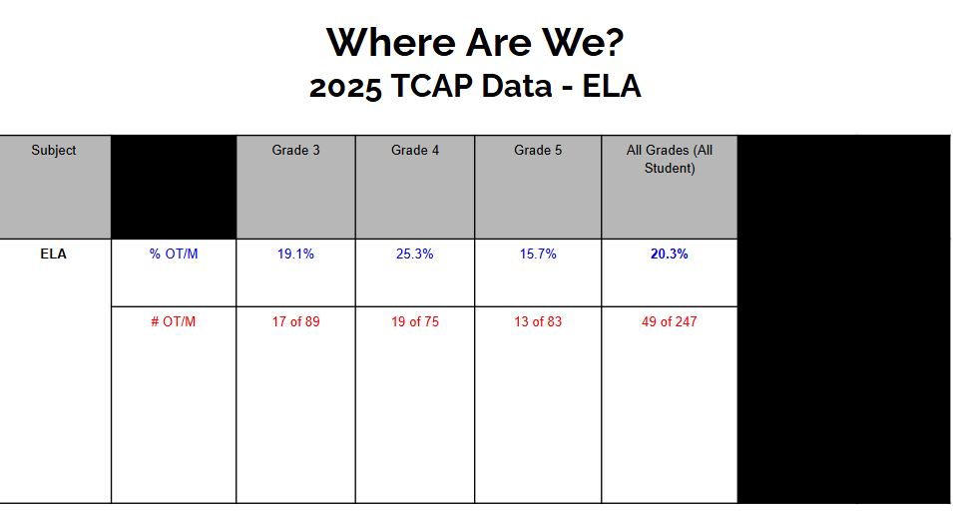
LEARN. LEAD. LEAVE A LEGACY.

Slide 25
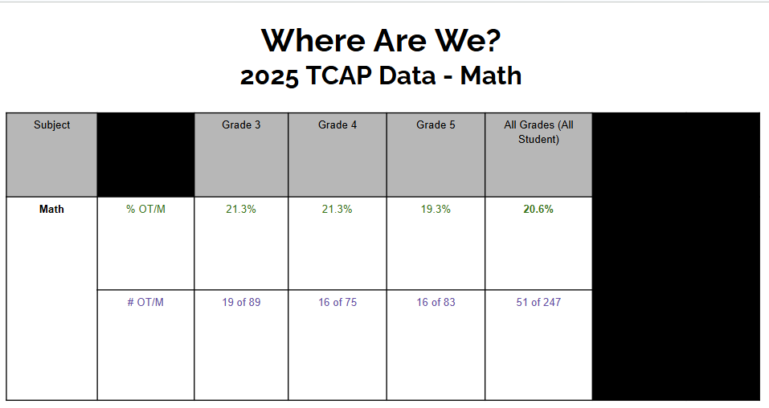
LEARN. LEAD. LEAVE A LEGACY.

Slide 26
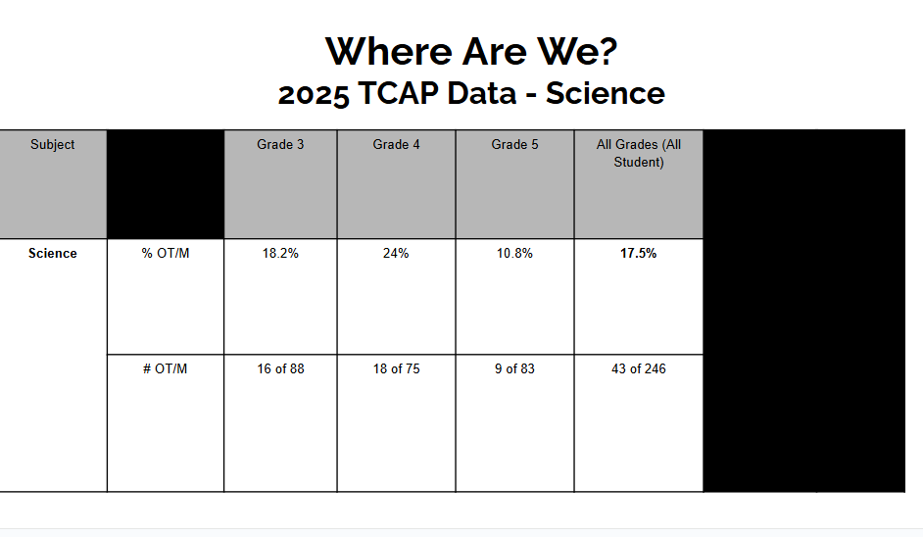
LEARN. LEAD. LEAVE A LEGACY.

Slide 27
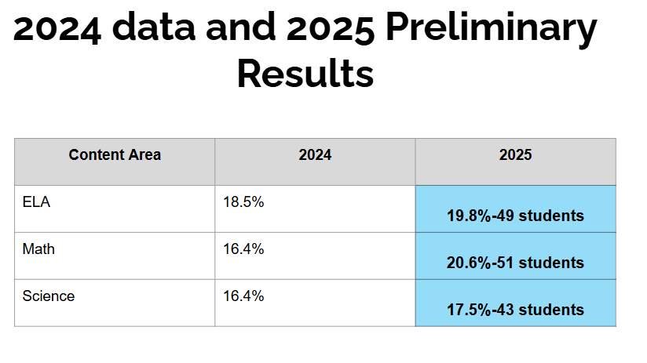
LEARN. LEAD. LEAVE A LEGACY.

Slide 28

As a parent, how can I help?
Student drop-off starts at 7:55.
Students are tardy at 8:16.
No early dismissal after 2:00.
LEARN. LEAD. LEAVE A LEGACY.

Slide 29
Who can I contact for more information?
Dr. Tiffany Curry, Principal
Mrs. Marion Gross, PLC Coach
Dr. Krystal Polk, PLC Coach
Ms. Betty Lee, School Counselor
Mrs. Ashley Owens Davis, School Counselor
Ms. Kelly Connor, Interventionist
LEARN. LEAD. LEAVE A LEGACY.

Slide 30

LEARN. LEAD. LEAVE A LEGACY.

